Slide 1
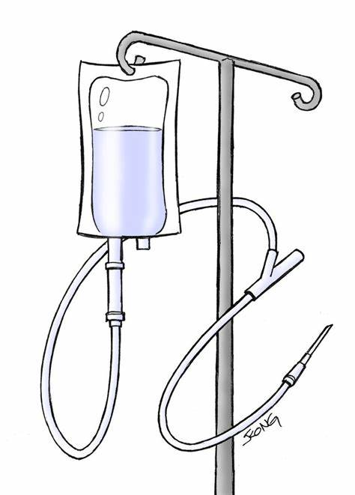
Is a warming cabinet a viable alternative to fluid warmers? Reducing the environmental burden of Anaesthesia:
Owen M (Consultant in Anaesthesia), O’Reilly H (FY2), Blenkinsop L (FY2), Ferguson E (Medical Student), Fuller A (Medical Student), Lorn and Islands District General Hospital, Oban, United Kingdom.
Disclaimer: No funding was sourced for the duration of the project.
Results
In the first cycle, 4 patients were actively warmed with either a warm air blanket and/or a fluid warming device. 14 patients were given unwarmed fluids. 10 patients received neither fluids nor active warming.
In the 24 patients who were not actively warmed the average change in temperature was - 0.3 degrees
Those unwarmed patients who were also given unwarmed fluids had the greatest fall in temperatures. Of the 14 in this group, the average change was - 0.5 degrees.
In the second cycle we collected data on 18 patients. 13 patients received pre-warmed fluids from the warming cabinet, but were not actively warmed by other means, and the average change in temperature in this group was +0.1 degrees, as compared with -0.5 degrees in the same group in the first audit cycle.
We now routinely pre-warm all IV fluids in a warming cabinet. We hope this will improve perioperative temperature management and reduce the unnecessary use of the fluid warming device which uses costly giving sets with plastic waste.
We have also highlighted the need for continuous core temperature measurement when using active warming methods to avoid hyperthermia.
Harper CM. Maintaining Perioperative Normothermia. BMJ. 2003;326(7392):721–
Sessler DI. Perioperative heat balance. Anesthesiology 2000;92:578– 596.
Scottish Government. NHS Scotland climate emergency and sustainability strategy: 2022-2026. Available from: https://www.gov.scot/publications/nhs-scotland-climate-emergency-sustainability-strategy-2022-2026/#:~:text=To%20play%20our%20part%20in,developing%20low%2Dcarbon%20health%20systems.. (Accessed 20.03.2023)
Introduction
Temperature is an important consideration in perioperative care.
Hypothermia has been associated with increased morbidity, prolonged recovery times and increased blood loss.¹
Hyperthermia is also associated with cellular damage and subsequently poor recovery.²
General anaesthetics are well known to reduce core body temperature.^{1,2} Current warming techniques include costly fluid warmers which use energy and generate plastic waste.
NHS Scotland is attempting to reach net-zero carbon emissions by 2040.³
To determine whether storing fluids in a warming cabinet is a viable alternative to a fluid warming device for perioperative temperature management.
Actively Warmed (Fluid Warmer/Blanket)
No Fluids Given
Unwarmed Fluids
Methods
Figure 1: A graph showing average temperature changes in the first cycle. Three different patient groups were recorded.
We conducted two snap audits to look at perioperative body temperature in patients undergoing general anaesthesia. Temperature was taken using an infrared tympanic thermometer immediately after induction, during surgery at 30 minute intervals and at the end of the procedure.
We also recorded whether patients were actively warmed (by other means), length of procedure and amount of IV fluids given (if any).
We collected data on 28 patients in the first cycle.
In the second cycle we stored IV fluids in the warming cabinet in theatre at a temperature of 37 degrees. Having made this change, we conducted a second audit for a further month and collected temperatures on 18 patients.
Cycle 2: Average Temperature Change in
Celsius
Aim
Conclusions
Warming Cabinet Fluids
Actively Warmed (Blanket)
No Fluids Given
References:
Figure 2: A graph showing average temperature changes in the second cycle. IV fluids were stored in a warming cabinet for this cycle.
Acknowledgements: Many thanks to theatre staff at Lorn and Islands Hospital for facilitating this project.

